Slide 1
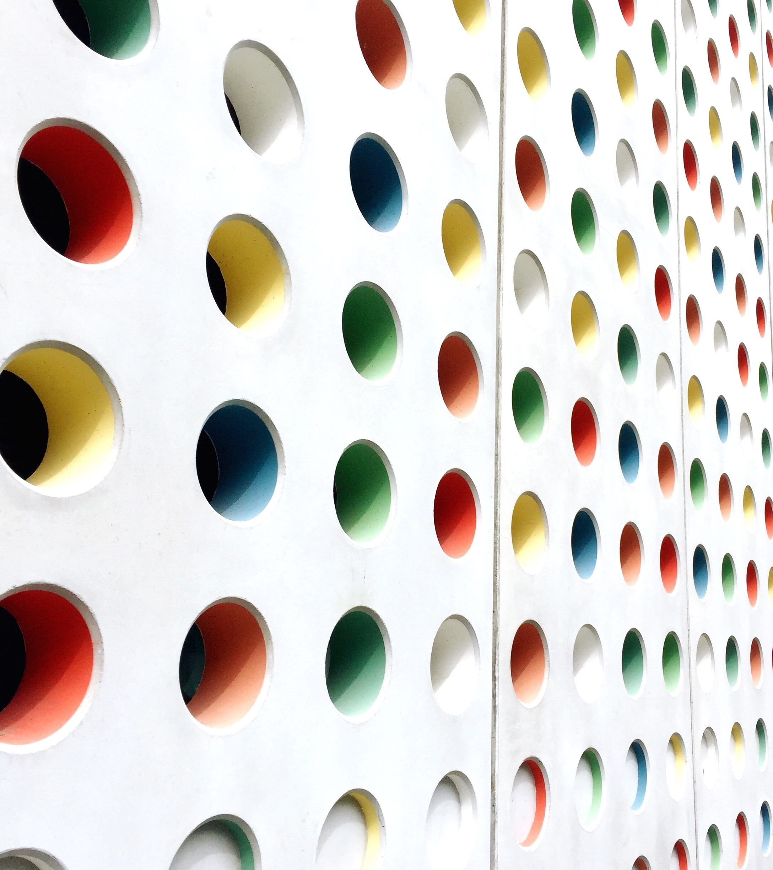
Welcome to the Art Forms of India
Aadit Bisht
Grade 5 E

Slide 2
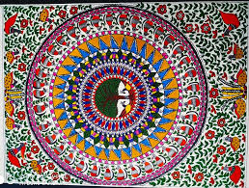
Madhubani : An Art that Goes Beyond Colours

Slide 3
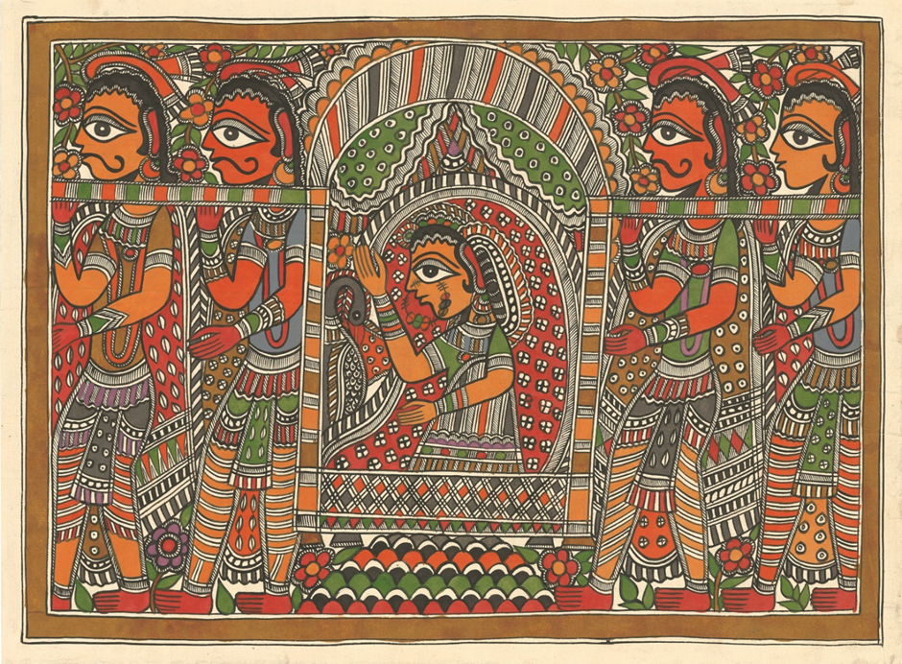
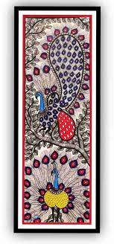
Madhubani Art
Madhubani Art is a style of painting practiced in the Mithila region of India.
It is named after the Madhubani District of Bihar , India.
Madhubani Paintings were first created at Mithila , the birthplace of Hindu Goddess Sita. It is believed that the paintings capture the moments of marriage between Lord Rama and Goddess Sita.
Artists create these paintings using a variety of mediums including their own fingers , twigs , brushes and matchsticks

Slide 4
Madhubani Art
This art is famous for its diverse themes that capture the meaning of life and spirituality . The paintings usually show scenes from Hindy Mythology , showcasing Gods and Goddesses like Krishna , Radha , Shiva and Durga
This Art for has ties to the Self Employed Women’s Association (SEWA) of Madhubani.
The Artists have been featured in multiple museum collections and exhibitions.
Madhubani Painting received official recognition in 1969 when Sita Devi received the State Award by Government of Bihar.

Slide 5
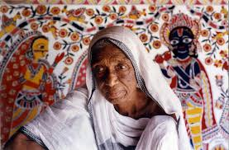
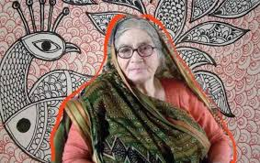
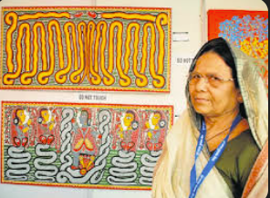
Famous Personalities
Sita Devi
Godavari Devi
Baua Devi

Slide 6
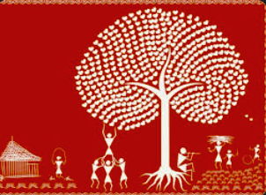
Warli Art: With the Tribal Heart

Slide 7
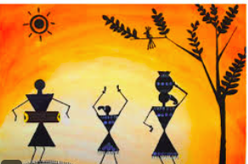
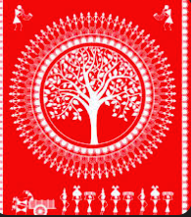
Warli Art
Warli Painting is a form of tribal mural created by the tribal people from the North Sahyadri Range in Maharashtra , India.
The Warlis are the tribes living in mountains as well as coastal areas of Maharashtra and Gujrat.
Warli Art Form is driven by everyday life stories and these tales also in turn become a reminder of traditional values and cultures cherished by the tribe.
Their themes revolve around depiction of daily life activities rather than mythological themes. Unlike Madhubani paintings that use bright colours , these are painted on mud and cow dung-based surface using earth colours or rice paste in white.

Slide 8
Warli Art
These paintings use a set of geometric shapes : a circle , a triangle and a square. These shapes are symbolic of different elements of nature . The circle represents sun and moon , while the triangle depicts mountains and conical trees.
The central motif in each ritual painting is the square known as the “Chauk” and the “Chaukhat”.
A white pigment made from a mixture of rice flour and water , with gum as binder is used for Warli paintings. A bamboo stick is chewed at the end to give it the texture of a paintbrush.

Slide 9
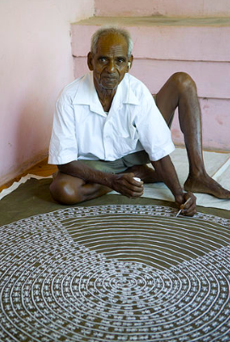
Warli Art
Jivya Soma Mashe is known as the “Father of Warli
Paintings”

Slide 10
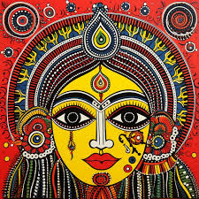
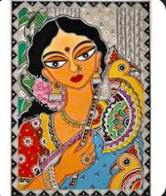
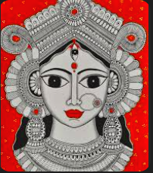
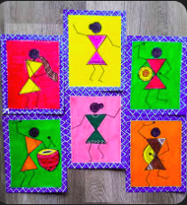
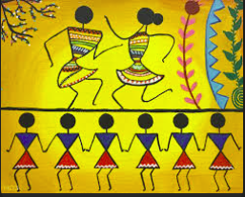
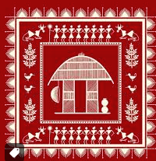
Some Glimpses of the Art
Forms!!

Slide 11
Thankyou!!!

